Slide 1
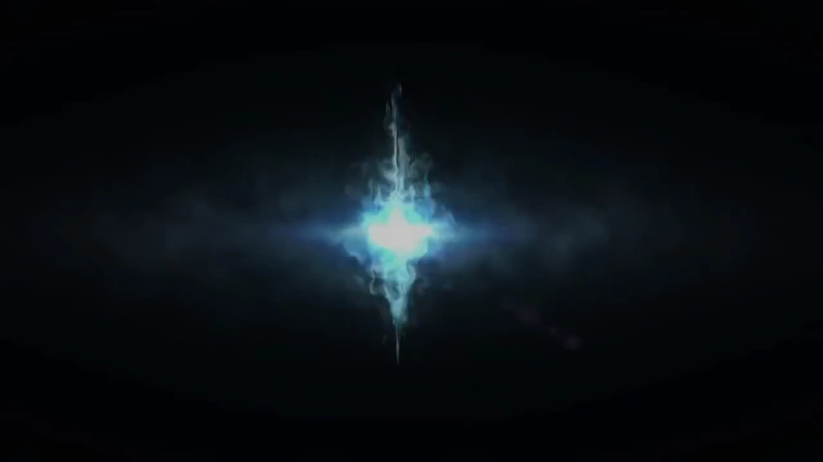
MTG Deck Starter
Presented by Shweta Chandramouli and Abhinandan Patni

Slide 2
MTG Deck Starter
Presented by Shweta Chandramouli and Abhinandan Patni

Slide 3
OUTLINE
Introduction
Related Work
Our Work
Impact of this project
Conclusion and Future work

Slide 4
INTRODUCTION
What is MTG?
Most popular trading card game
Started in 1993, has 20 million players today.
What are some of the problems players face?
What colors?
What strategy?
Where does Machine Learning come in?

Slide 5
PROBLEM STATEMENT
To create a system that suggests deck color(s) for players wishing to utilize certain mechanics of the MTG game for a new deck.

Slide 6
Related Work
The AI that learned Magic The Gathering.
AI bot that auto generated valid MTG cards using previous knowledge of officially distributed cards.
Magic The Gathering Deck Performance Prediction.
K-means clustering was used to classify decks.
Scores from 1 to 1000 were given to decks, depending on how well the decks would fare in professional tournaments.

Slide 7
OUR WORK
Gather data
Obtain features from data
Find co-relation between every feature and color of the card
Use the best feature obtained above to classify future MTG mechanics
Based on such classification, suggest colors for decks.

Slide 8
GATHERING DATA and DATA PRE-PROCESSING

Slide 9
Obtaining Features
{
"name" : "Sen Triplets”,
"manaCost" : "{2}{W}{U}{B}”,
"cmc" : 5,
"colors" : ["White", "Blue", "Black"],
"supertypes" : ["Legendary"],
"types" : ["Artifact", "Creature"],
"subtypes" : ["Human", "Wizard"],
"rarity" : "Mythic Rare”,
"text" : "At the beginning of your upkeep, choose target opponent. This turn, that player can't cast spells or activate abilities and plays with his or her hand revealed. You may play cards from that player's hand this turn.”,
"power" : "3”,
"toughness" : "3”,
"multiverseid" : 180607
}

Slide 10
FIND CORELATION

Slide 11
CLASSIFICATION
We used 4 methods:
Naïve Bayes
Better Naïve Bayes
SVM
Regression/something

Slide 12
RESULTS

Slide 13
RESULTS

Slide 14
CONCLUSION & FUTURE WORK

Slide 15
THANK YOU!
QUESTIONS?

